Slide 1
Postman
Request resource with token
Security Filter
Resource Response
JWT
Oauth2
Resource
token
Request token
Authorized
OpaqueToken
Keycloak
Authorize
Authorization

Slide 2
Postman
Request resource with token
Security Filter
Resource Response
JWT
Oauth2
Resource
token
Request token
Authorized
OpaqueToken
Keycloak
Authorize
Authorization

Slide 3
Postman
Request resource with token
Security Filter
Resource Response
JWT
Oauth2
Resource
token
Request token
OpaqueToken
Keycloak
Authorization

Slide 4
Method Level Authorization
JWT
Security Filter Level Authorization
Oauth2
Resource
Method Level Authorization
OpaqueToken
Security Filter Level Authorization
Authorization

Slide 5
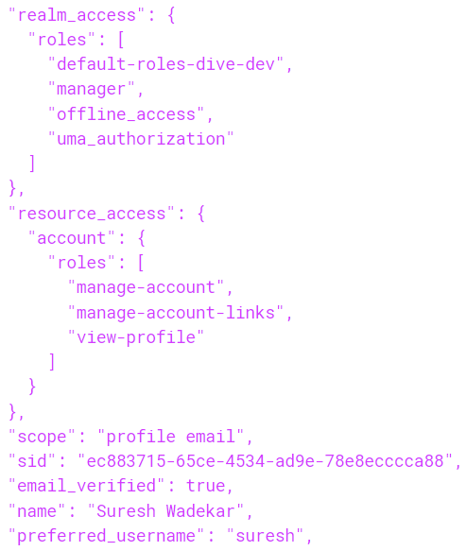
JWT - Method Level Authorization
Incoming JWT token is adjusted to Spring Boot Oauth2 format

Slide 6
JWT - Method Level Authorization
Contains default JWT Authentication Converter
JwtAuthenticationConverter
JWT
Configuration
Authorization

Slide 7
JWT - Method Level Authorization
JwtAuthenticationConverter
Check if token contains property “scope” or “scp” in jwt access token.
Checks for “scp” only if “scope” is unavailable.
Append the prefix “SCOPE_” to each entry in the value of the property.
Works on only the String value having roles separated by space.
Or a string array of roles.
Adds these appended entries as roles in JwtAuthenticationToken class.
These are then used to authorize each API accordingly.
Authorization

Slide 8
JWT - Method Level Authorization
JwtAuthenticationConverter
Keycloak - JWT
“scope” : “profile email”
roles = [“profile” “email”]
Add prefix “SCOPE_”
roles = [“SCOPE_profile” “SCOPE_email”]
new JwtAuthenticationToken(jwt, roles)
Roles do not have “manager”
Authorization

